Slide 1

Real Time Project
Date:-03-05-2024
Frist Review on
RFID AND FINGERPRINT BASED EXAMINATION ROOM IDENTIFICATION
Under The Guidance of
Dr.Sudha Chandrika
Associate Professor
Batch No : 05
1] G.Susmitha (227R1A0481)
2] K.Dhanunjay (227R1A0485)
3] J.Dhanush (227R1A0469)
4] T.Kiran Chaithanya (227R1A04B9)
Project Coordinator
Dr.K.Bharath Kumar
Associate Professor

Slide 2
CONTENTS :
Abstract
Introduction
Literature survey
Problem statement
Problem Methodology
Requirements
References
Result

Slide 3
ABSTRACT:
The goal of this project is to provide guidance to students at examination centers.
Many students are having difficulty finding rooms. Most students are worry while going to the examination, and they even feel tense while looking for their exam location.
In these instances, our project is beneficial. As a hall ticket, each student will be given an RFID card.
That will automatically display the room number of the student. Our project will primarily save time spent searching for a room in examination centers.
Keywords: Arduino, Examination Room Guidance, RFID System, Fingerprint Module, Lcd Display.

Slide 4
INTRODUCTION:
RFID (Radio Frequency Identification) technology is a new technology that is being used in a various application.
RFID is made up of two major components. The Interrogator (RFID Reader) sends and receives the signal, as well as the Transponder (tag) attached to the object.
Improvements in RFID technology: memory capacities, reading ranges, and processing speeds continue to improve.
The integrated circuit in an RF tag will never be as cost effective as a bar code label

Slide 5
Literature survey:-
S.NO | Name of the authors | Name of the journal | Year of Publication | explanation (Adv/Disadv)
1 | C Vijaya Bhaskar1, P. Ruchita. | International Research Journal of Modernization in Engineering Technology and Science | May - 2022 | The system is designed to pass only uses by verifying their fingerprint module The ID and the other personal details which where propely saved in database of the system and confirm the eligibility of candidate for examination The tag identification can not seen by our nacked eye
2 | Z. yongqang. | International Conference on Communication Technology | Nov - 2006 | A wireless fingerprint module based on the attendance system which uses the fingerprint module AR400 RFID and handled MC 9000-GRFID reduces human effort and error

Slide 6
S.NO | Name of the authors | Name of the journal | Year of Publication | explanation (Adv/Disadv)
4 | Mr.N.JyothiSwaroop Mr. P.Nagarjuna Mr. Ch. Seshu kumar | International journal of electrical and electronics engineers | June - 2022 | By combining both RFID and microcontroller generates a project with wider boundaries and effective solutions. More capabilities are being added, such as the ability to keep track of a student's details, such as fees due.
5 | S. Martin’, R. Gil’, J. Bravo. | Electrical and Computer Engineering Department Spanish University for Distance Education (UNED). | 2007 | This includes reducing waiting times for class access and real-time identification of students entering and exiting the examination room. The coverage range of RFID is limited which is about 3 meters.

Slide 7
S.NO | Name of the authors | Name of the journal | Year of Publication | explanation (Adv/Disadv)
5 | K. Vandana, K. Anil Kumar. | International Research Journal of Engineering and Technology (IRJET) | Apr - 2018 | For the existing system we can also add figure print authentication and face recognition system can also be implemented for the purpose of better safety. reduces human effort and error
6 | Mr. D. S. Chaware1 Mr. V. M. Pund. | International Journal for Scientific Research & Development | Nov -2017 | By integrating RFID Technology, we could successfully develop an embedded system for examination room guidance. All RFID tags within range can be detected instantly and matched with information in your database.

Slide 8
S.NO | Name of the authors | Name of the journal | Year of Publication | explanation (Adv/Disadv)
7 | A. N. Nambiar A Supply Chain Perspective of RFID Systems | International Journal of Industrial and Manufacturing Engineering | Dec - 2009 | RFID systems facilitate automatic and remote identification of components Tag identification that is not visible to the naked eye.
8 | *RKAR. Kariapper, MS. *Suhail Razeeth. | International Research Journal of Modernization in Engineering Technology and Science | 2005 | A RFID BASED (IoT) AUTOMATIC ATTENDANCE SYSTEM: A SURVEY ANALASIS This attendance system software has been developed using VB.net and database (Microsoft Access)

Slide 9
Problem statement:-
In the context of examination centers, especially those implementing a jumbling system, students often face challenges in locating their examination rooms.
This can lead to anxiety and confusion, potentially impacting their performance.
The goal is to develop an Examination Room Guidance System using RFID (Radio Frequency Identification) technology to streamline the process of guiding students to their respective rooms efficiently

Slide 10
Problem Methodology:-
FINGER PRINT MODULE
RFID TAG
ARDUINO UNO
POWER SUPPLY
EM-18 READER MODULE
BUZZER
LCD DISPLAY
LED

Slide 11
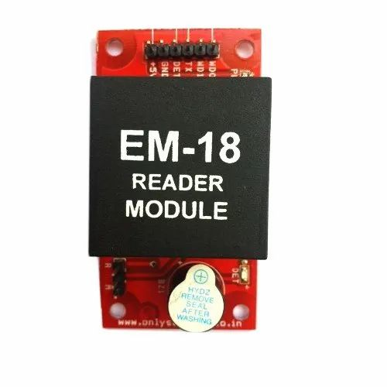
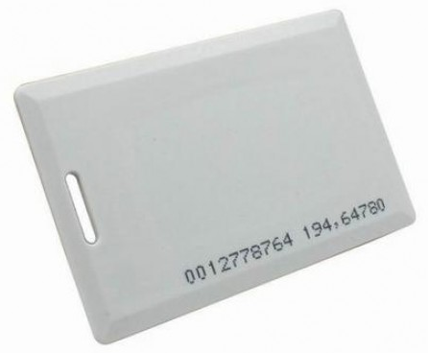
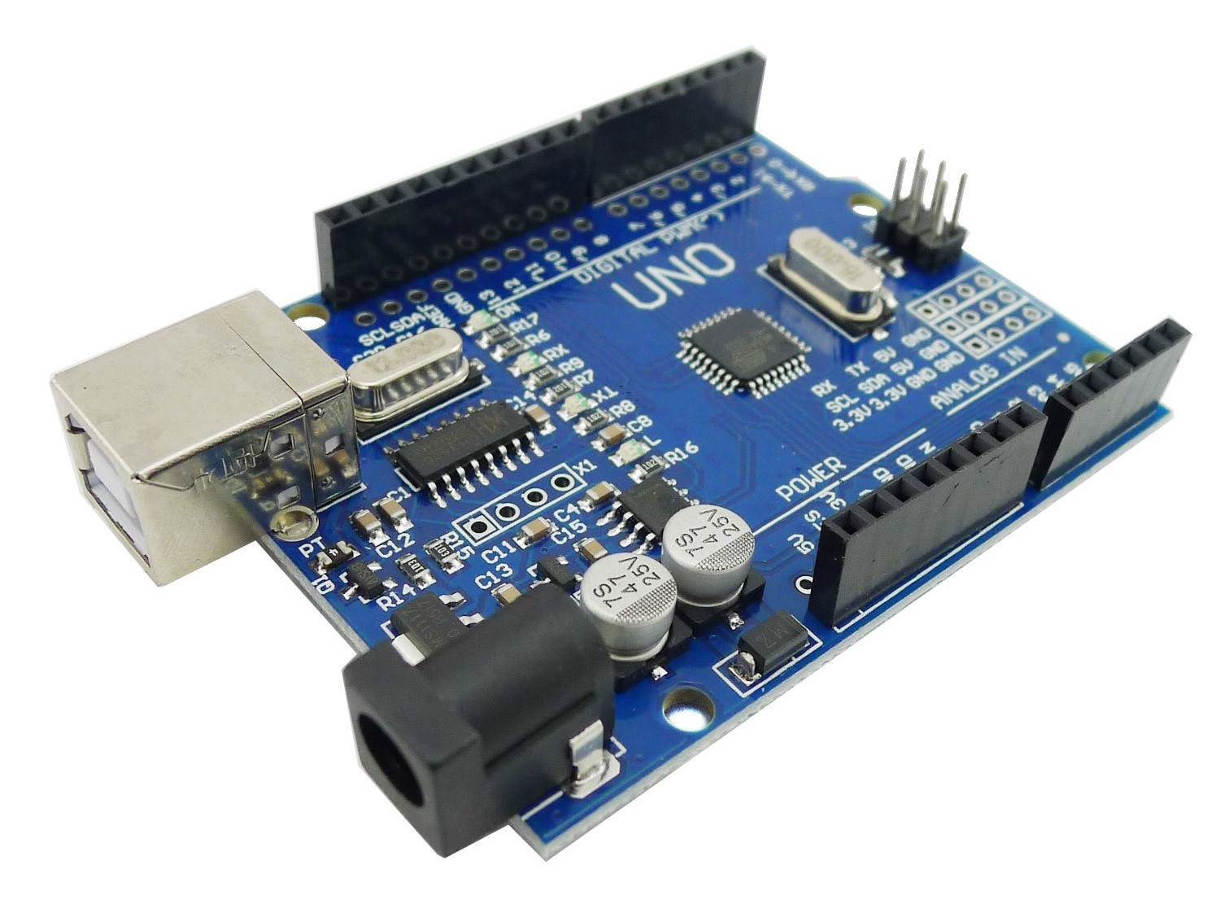
Requirements:-
Hardware required :
s
1) ARDUINO UNO
2) RFID Reader
3) RFID Tag

Slide 12
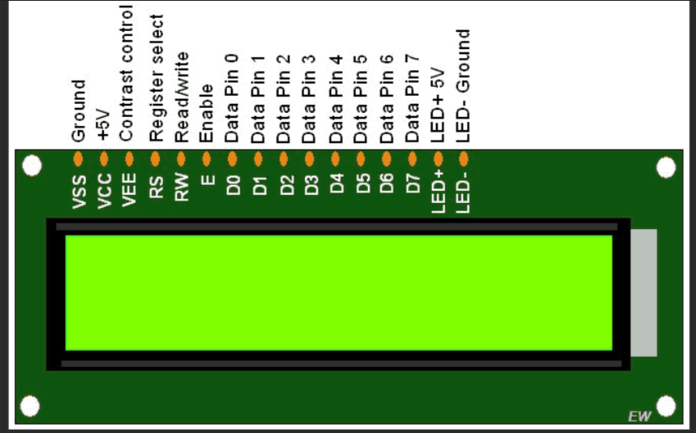
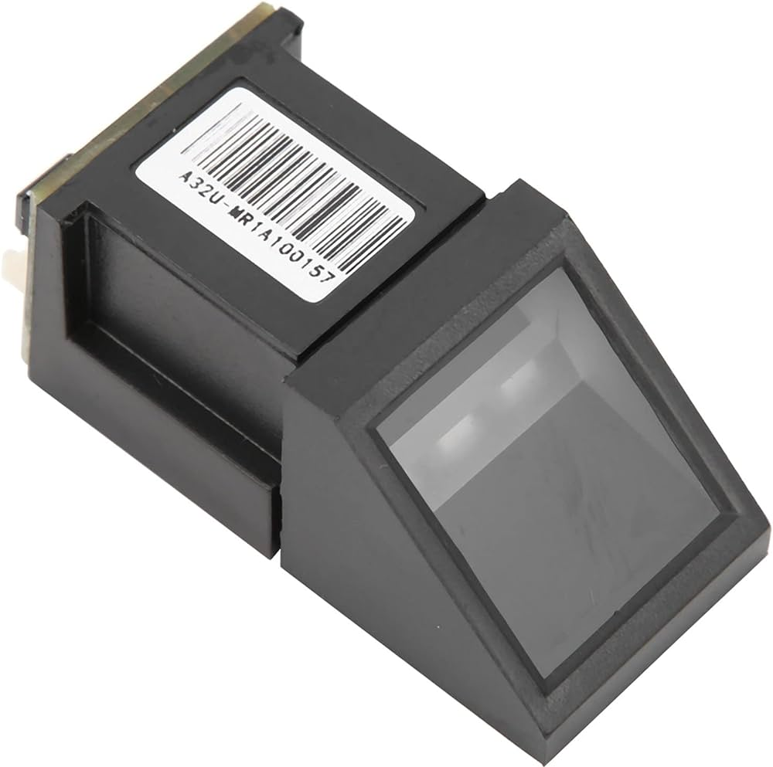
4) LCD display
5) Fingerprint sensor

Slide 13
Applications :
Disadvantages:
TIA/teEIA-232-F
Battery powered systems
Terminals
Modems
Computers
Active RFID is costly due to use of batteries.
The Coverage range of RFID is limited which is about 3 meters.
RFID devices need to be programmed which requires enough amount of time.
Advantages:
reduces human effort and error
All RFID tags will maches within range can be detected instantly
Larger area of coverage, Up to several feet.
RFID can be used in addition to Bar Code.

Slide 14
References:-
[1] RFID Sens Net Lab “ A white paper on Automatic Attendance System” Texas A & M University, Texas, USA, 2005.
[2] Z. youngling, L. Ji “The Design of Wireless Fingerprint Attendance System” International Conference on Communication Technology, ICCT '06, Handan, Hebei, China, 27-30 November 2006, pp. 1-4, 2006.
[3] RFID Sens Net Lab “ A white paper on Automatic Attendance System” Texas A & M University, Texas, USA, 2005.
[4] Mohmmed A.B, Abdel-Hamid A and Mohammed K.Y,” Implementation of an improved secure system detection for E password by using EPC RFID tags”, World Academy of Science and technology Journal, Volume 6, ppl-5,2009.
[5] Nambir A.N,” A supply chain perspective of RFID Systems”, World Academy of science, Engineering and Technology Journal, Volume 6, ppl-5,2009.
[6] Liu C.M and Chen L. “Applications of RFID Technology for improving production efficiency in an Integrated circuit packaging house”, International Journal of Production Research, Vol 47, no. 8, pp. 2203-2216, 2009.

Slide 15
[7] Mohmmed A.B, Abdel-Hamid A and Mohammed K.Y,” Implementation of an improved secure system detection for E password by using EPC RFID tags”, World Academy of Science and technology Journal, Volume 6, ppl-5,2009.
[8] S. Martin', R. Gil', J. Bravo2, R. Hervas2, M. Castro', J. Peir' “Increasing throughput and personalizing the examination process in universities using RFID “, Electrical and Computer Engineering Department Spanish University for Distance Education (UNED).
[9] M. Brandl, J. Grabner, K. Kellner, F. Seifert, J. Nicolics, S. Grabner, and G. Grabner, "A low-cost wireless sensor system and its application in dental retainers," IEEE Sensors Journal, vol. 9, no. 3, pp. 255-262, 2009.
[10] Y.-J. Tu, W. Zhou, and S. Piramuthu, "Identifying rfid-embedded objects in pervasive healthcare applications," Decision Support Systems, vol. 46, no. 2, pp. 586-593, 2009.

Slide 16

FINAL RESULT:
We have tried by using different components.
IMPLEMENTATION 1:
First our project is about RFID AND FINGERPRINT BASED EXAMINATION ROOM IDENTIFICATION. Let us go for the implementation -1. For this first we have to enroll our fingerprints in the fingerprint module by using the SFG software.
1.Say for example let us take person-1 if he keeps his finger on the fingerprint module then we can see “FINGERPRINT SUCCESSFUL SHOW RFID TAG” on the LCD display.

Slide 17
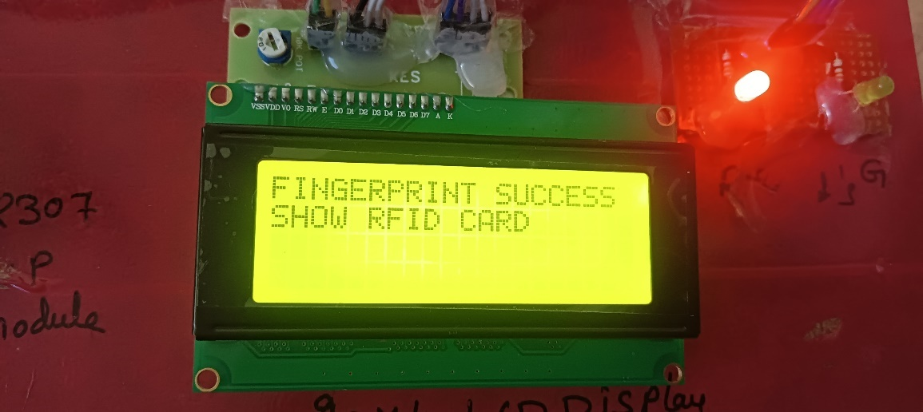
Step 1 - Result

Slide 18
2) Next we need to show the RFID tag , this tag is scanned by the RFID reader module .
Then we can observe the first person details (NAME, HALL TICKET ,BRANCH, BLOCK, ROOM NUMBER).
At the same time if we observe the green LED will glow. We can see the output below.

Slide 19
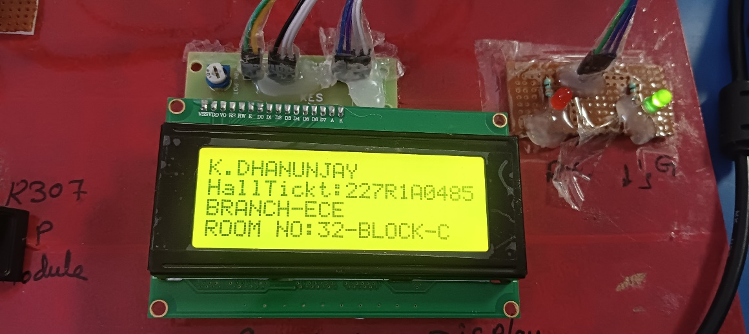
Step 2 - Result

Slide 20
IMPLEMENTATION 2 :
Let us take another scenario in this the second person places his/her finger on the fingerprint module .
Then the LCD will display that “FINGERPRINT SUCCESSFUL SHOW RFID TAG” so instead of showing the 2nd persons RFID tag we tried with the 1st persons RFID tag .
When we place the 1st person RFID tag to the RFID reader module.
It will show that“RFID NOT MATCHED WITH THE FINGERPRINT” on the LCD display . At this condition the RED LED will glown . We can see the output below.

Slide 21
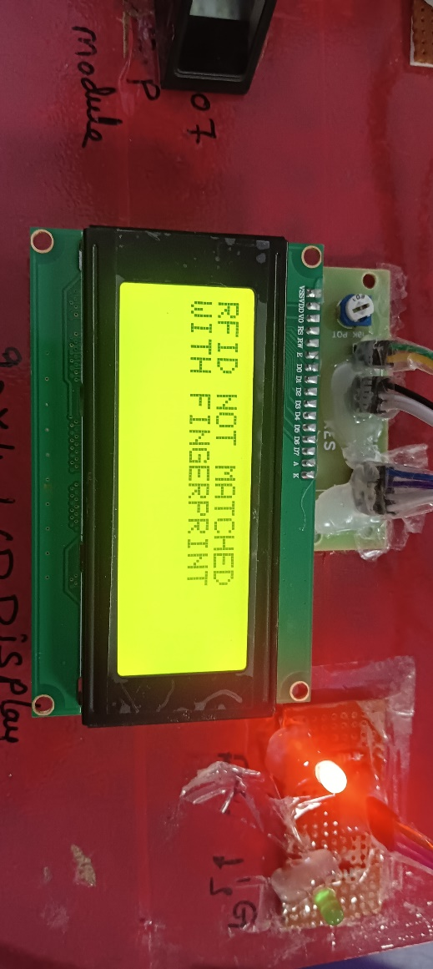
Implementation 2 – Result

Slide 22
IMPLEMENTATION 3 :
If we go with the implementation 3 in this we have used ID card (BARCODE) instead of RFID tag . In this case the RFID reader module will not scan the ID card (BARCODE) of the student. Because RFID reader module will only scan the RFID tag. In In this case if we observe the red LED will glow.
IMPLEMENTATION 4 :
In this case we have replaced the RFID tag with the QR code (scanner ). In this case the RFID reader module will not scan the QR code (scanner ) . Because RFID reader module will only scan the RFID tag. In this case also the red LED will glow.

Slide 23
CONCLUSION: We were able to design an embedded system for examination room navigation that was both cost-effective and time-efficient by combining RFID technology and a fingerprint module. The existing method can be improved by adding an infrared sensor and utilised to track attendance. As a result, the system offers a wide range of potential development that can lead to significant advancements.
FUTURE SCOPE: In addition to the present system, a facial recognition system can be incorporated for increased safety. More capabilities are being added, such as the ability to keep track of a student's details, such as fees due, library transactions, and attendance. The notion is not only useful to students but also to corporations, depending on how well it is implemented, as seen by the seeds that have sprouted into a variety of viable projects.

Slide 24


